Slide 1

Machine Learning
- Model Building
& Training -
Session 3:
September 29th
14:00 – 14:45 ITU AI/ML in 5G Challenge

Slide 2
Previous Mentoring Sessions
9/6 Computer Networks Introduction
**Will be out on the neural network and youtube on Wednesday next week
9/15 Data Preprocessing
You can find all resources from the previous mentoring sessions here: https://github.com/ITU-AI-ML-in-5G-Challenge/MentoringSessions2022
(link will be posted in the chat)

Slide 3





Machine Learning Steps
Last Session
Collect data
Data
Preprocessing
Model
Training
Evaluation
Deployment

Slide 4
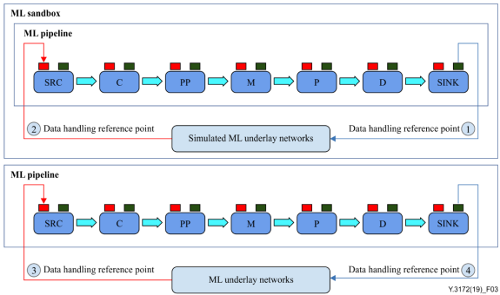
Machine Learning Steps
ITU Y.3172 (mentioned last session)
This Session
Collect data
Data
Preprocessing
Evaluation
Deployment
Model
Training
C : Collector PP: Pre-processor
M : Model
P : Policy
D : Distributor
SRC: Source of data
SINK: Target of ML output

Slide 5
Table of Contents
Machine Learning Types
ML Model Design and Training
Jupyter Notebooks (Hands on)
Q&A session

Slide 6
Types of Machine Learning
Supervised Learning
Unsupervised Learning
Reinforcement Learning

Slide 7
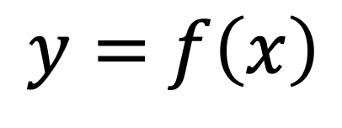
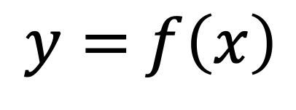
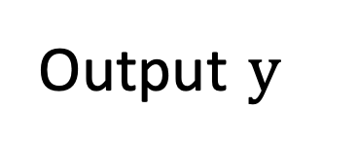
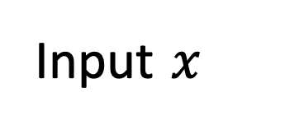
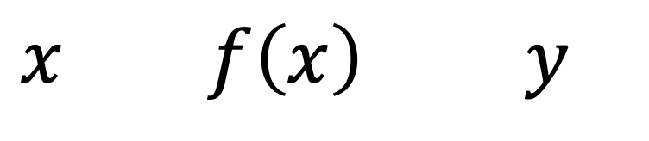

Supervised Learning
In mathematics…
In machine learning…
$$x$$
Training set:
Input $x$
Output $y$
$y=$ $f\left(x\right)$
Image/text/
system values
(= the data)
Corresponding label
The process:
$x$ $f\left(x\right)$ $y$
$y=$ $f\left(x\right)$
?
Input (feature)
Function (model)
Output (prediction)
Notes:
The training set will consist of input features and its corresponding label (for example, image of an apple and its corresponding label or text from a spam email and its corresponding label 0/1, or system metrics and corresponding label that system is up/down)
Creating a function (supervised learning)

Slide 8






Supervised Learning
banana
Use of labeled datasets
ML
apple
Pros | Cons
You are able to set the ideal boundary, without leaving it all to the algorithm to decide – high interpretability | In real life, data is often unlabeled and the labeling process can take a lot of time (it also requires a lot of domain knowledge to do)
Testing and debugging the algorithm is easy as you have full control over the learning process | It is limited – it will not find unknown information from the data like unsupervised learning can do
 | If we input data that does not belong to any of the classes, it will classify it anyway (which will be obviously wrong)
 | Training needs a lot of computation time
banana
apple

Slide 9
Unsupervised Learning
Use of unlabeled datasets
?
ML
Pros | Cons
It can pick up on patterns that humans may not be able to come up with | A lot of the time, the data can be quite biased (there is more data for one category than the other)
A lot of real life data is unlabeled data | Requires people to understand and analyse the output (requires a lot of domain knowledge)
 | Uncertain outputs (example above)

Slide 10
Reinforcement Learning
Robotics, AlphaGo & Autonomous Driving
Pros
It can be used to solve very complex problems that can not be solved by other learning algorithms
It can correct the errors that may have occurred during the training process
Agent
action
Cons
It can not be used in real time scenarios
It can not be used to solve simple problems
This learning requires a lot of data and a lot of computation (data-hungry).
Reward
Environment
Next state

Slide 11
Types of Machine Learning
Supervised Learning
Unsupervised Learning
Reinforcement Learning
Machine Learning
Classification
Regression
Clustering
Decision Making
Anomaly detection
Task driven
Data driven
Learning from mistakes
**this is not an exhaustive list

Slide 12
Machine Learning models
using
Supervised learning

Slide 13
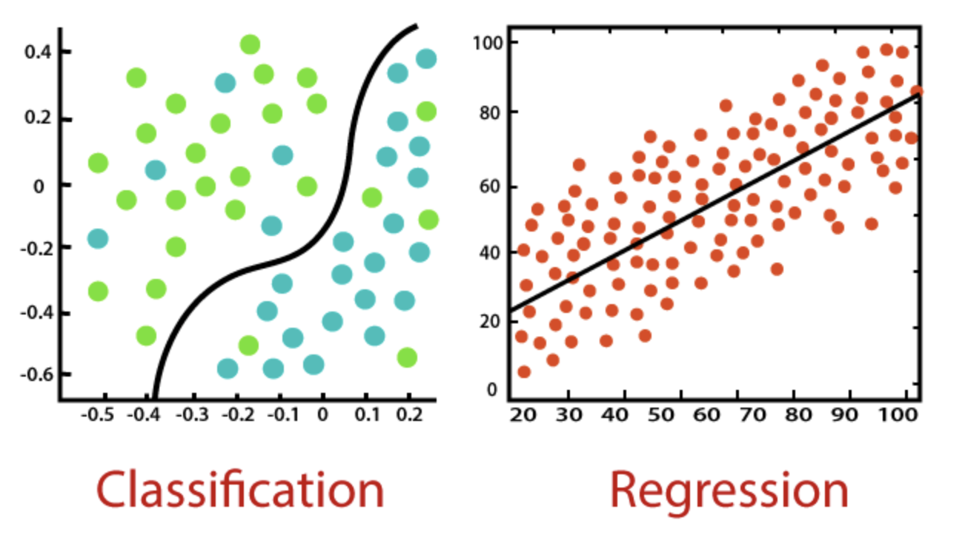
Supervised Learning
Classification vs Regression
{
Nearest Neighbor
Decision Trees
Random Forest
Logistic Regression
Classification
Regression
{
Linear regression
Support Vector Machine
Images from: https://www.javatpoint.com/regression-vs-classification-in-machine-learning

Slide 14
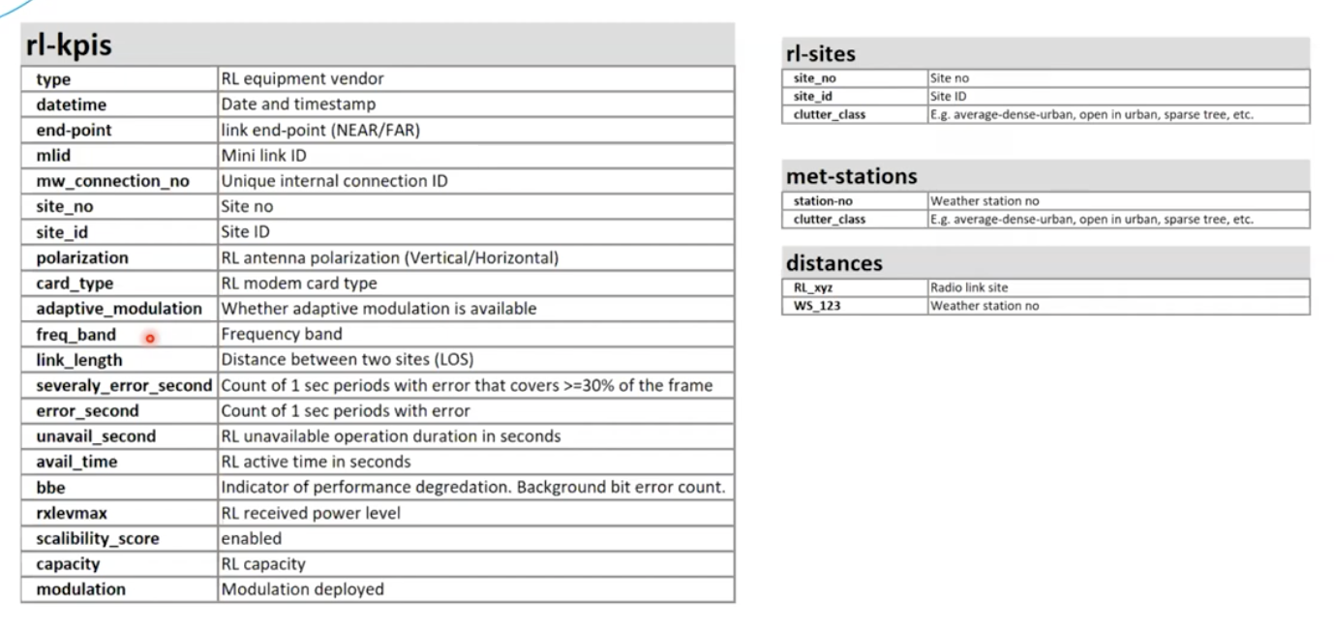
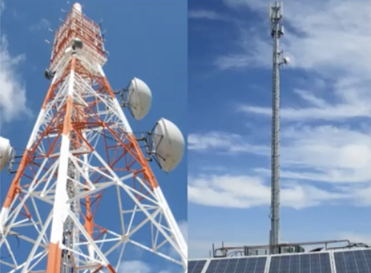
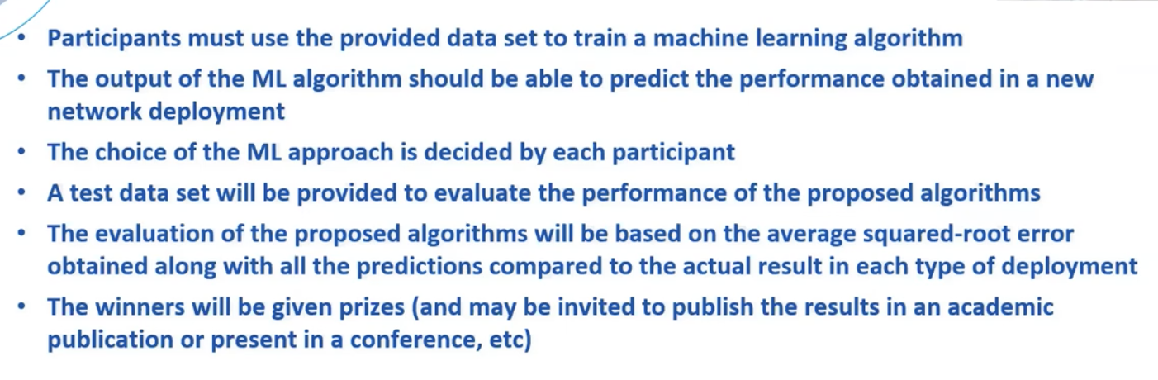
Radio Link Failure Prediction Challenge 2021
Turkcell
Images from the webinar: https://www.youtube.com/watch?v=lNg3zkZ6fA4&list=PLQqkkIwS_4kXzAb8yohjHlMVrIx8GNazO&index=39

Slide 15
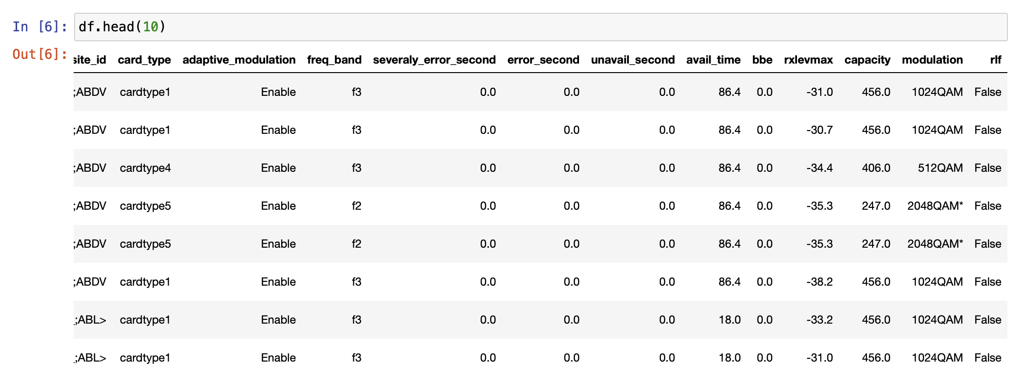
Radio Link Failure Prediction Challenge 2021
Turkcell
Baseline Model: https://github.com/Turkcell/ITU-AIMLin5GChallenge-2021/blob/main/RLF_Prediction_ITU_AIML_Challenge_Data/TurkcellExampleProject.ipynb

Slide 16
Building, training & testing the model

Slide 17
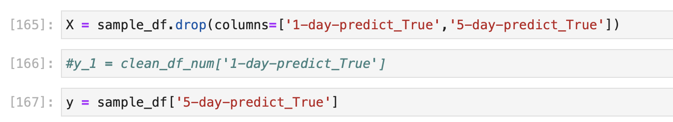
Splitting the data
Define input (X) and output (y) variables
Split the input and output variables into two or three subsets
Training data: to train the model (70% or 80%)
Test data: *unseen* data of a smaller proportion (20%) used to assess the performance of a trained model.
Validation data: to estimate the skill of the model

Slide 18
Building and training the model
Involves to define the model architecture and a set of ‘hyperparameters’.
→ Hyperparameters are used to fine-tune the accuracy of your Machine Learning model.
Fitting (training) the model
The last step is the training process.
The defined model is *fitted* to the training data during multiple training cycles (called ‘epochs’).
Hyperparameters are classified as…
model hyperparameters: influence the performance of the model
algorithm hyperparameters: affect the speed and quality of the learning process. Examples are ‘learning rate’ or ‘batch size’.
After your model is trained, you want to know the performance and accuracy of your model. For this reason, the evaluation of the trained model is an important step.

Slide 19
Model evaluation
General metrics:**
**Mean Absolute Error (MAE)**: Mean Absolute Error is the average of the difference between the original and the predicted values. MAE shows how far the predictions were from the actual output **Root Mean Squared Error (RMSE)**: RMSE is a standard way to measure the error of a model. RMSE is often used to evaluate a trained model for usefulness / accuracy.
**Metrics specifically for classification problems:**
**Overall Accuracy Score**: Accuracy is the ratio of number of correct predictions to the total number of input samples.
**Confusion Matrix**: A confusion matrix is a matrix which describes the complete performance of the model.
**Recall (Sensitivity)**: Recall is the number of correct positive results divided by the number of all relevant samples. The higher the Recall the better.

Slide 20
Model evaluation
**Precision (Positive predictive value)**: Precision is the number of correct positive results divided by the number of positive results predicted by the classifier. The higher the Precision the better.
**F1 Score**: the F1 score helps to measure the metrics *Recall* and *Precision* at the same time and is the harmonic mean of both metric. The F1 score can be between 0 and 1.0.

Slide 21
How do you choose an
ML algorithm?

Slide 22
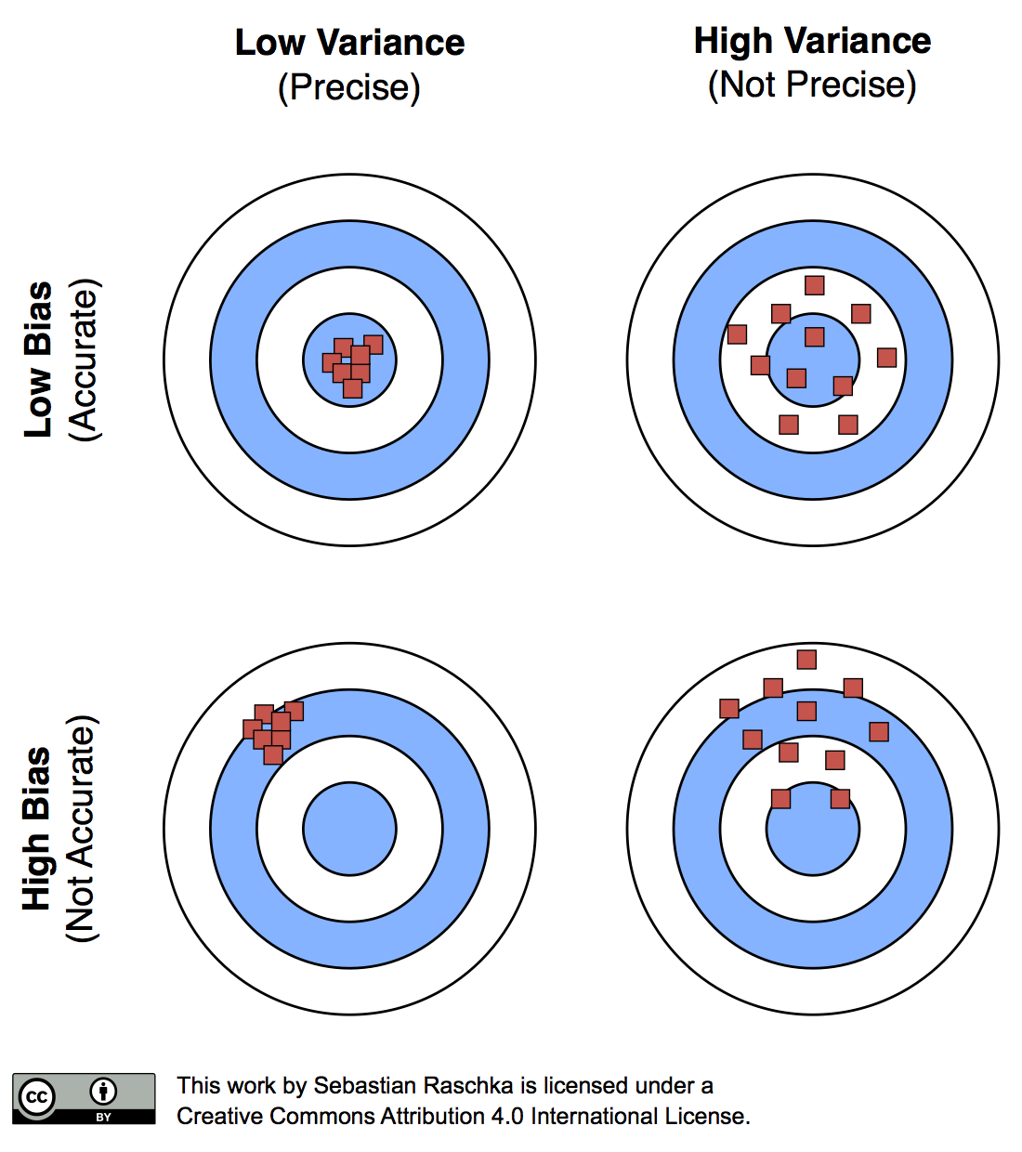
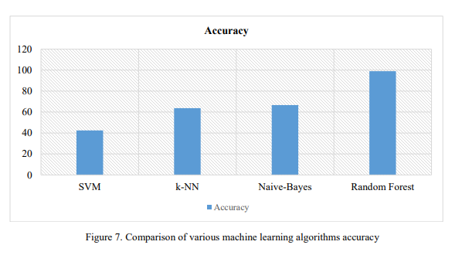
Choosing a ML algorithm…
Observations > Number of Features
Size of Training Data
Accuracy vs Interpretability of the output
Speed
Observations < Number of Features
Image from: Model evaluation, model selection, and algorithm selection in machine learning (sebastianraschka.com)
Graph from: Chaudhary, Kamika & Gupta, Neena. (2019). E-Learning Recommender System for Learners: A Machine Learning based Approach. International Journal of Mathematical, Engineering and Management Sciences. 4. 957-967. 10.33889/IJMEMS.2019.4.4-076.

Slide 23
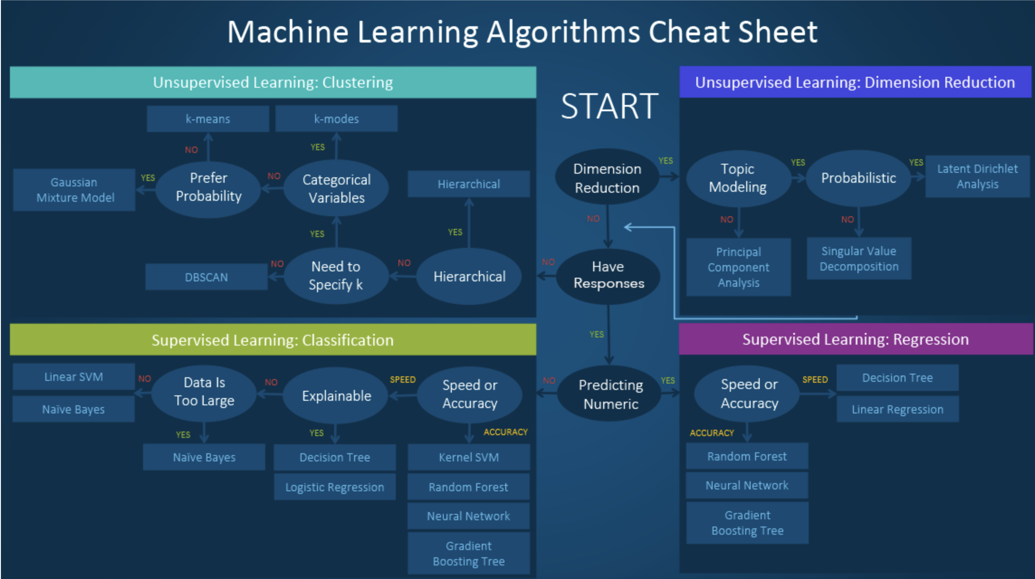
Image from: https://blogs.sas.com/content/subconsciousmusings/2020/12/09/machine-learning-algorithm-use/

Slide 24
References
Previous mentoring sessions:
9/6 Computer Networks Introduction
9/15 Data Preprocessing
https://github.com/ITU-AI-ML-in-5G-Challenge/MentoringSessions2022
Recommendation ITU-T Y.3172
Turkcell’s Problem Statement: https://github.com/Turkcell/ITU-AIMLin5GChallenge-2021/blob/main/RLF_Prediction_ITU_AIML_Challenge_Data/TurkcellExampleProject.ipynb
Papers
Chaudhary, Kamika & Gupta, Neena. (2019). E-Learning Recommender System for Learners: A Machine Learning based Approach. International Journal of Mathematical, Engineering and Management Sciences. 4. 957-967. 10.33889/IJMEMS.2019.4.4-076.

Slide 25

Jupyter Notebook
Practice

Slide 26
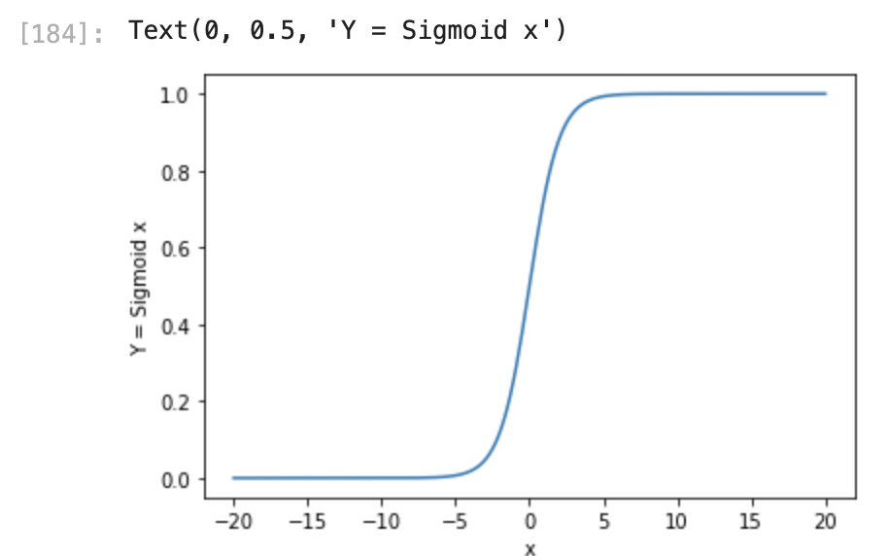



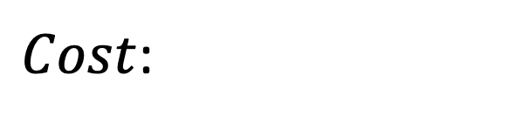
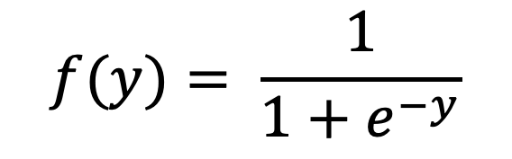
Logistic Regression
$$y=w1x1+w2x2+w3x3…+b$$
$$f(y)= \frac{1}{1+e^{−y}}$$
$Cost$:
$$−log⁡(f\left(y\right) if y=1$$
$$−log⁡(1−f\left(y\right) if y=0$$
$$→Gradient Descent$$

Slide 27
Q & A

